Slide 1
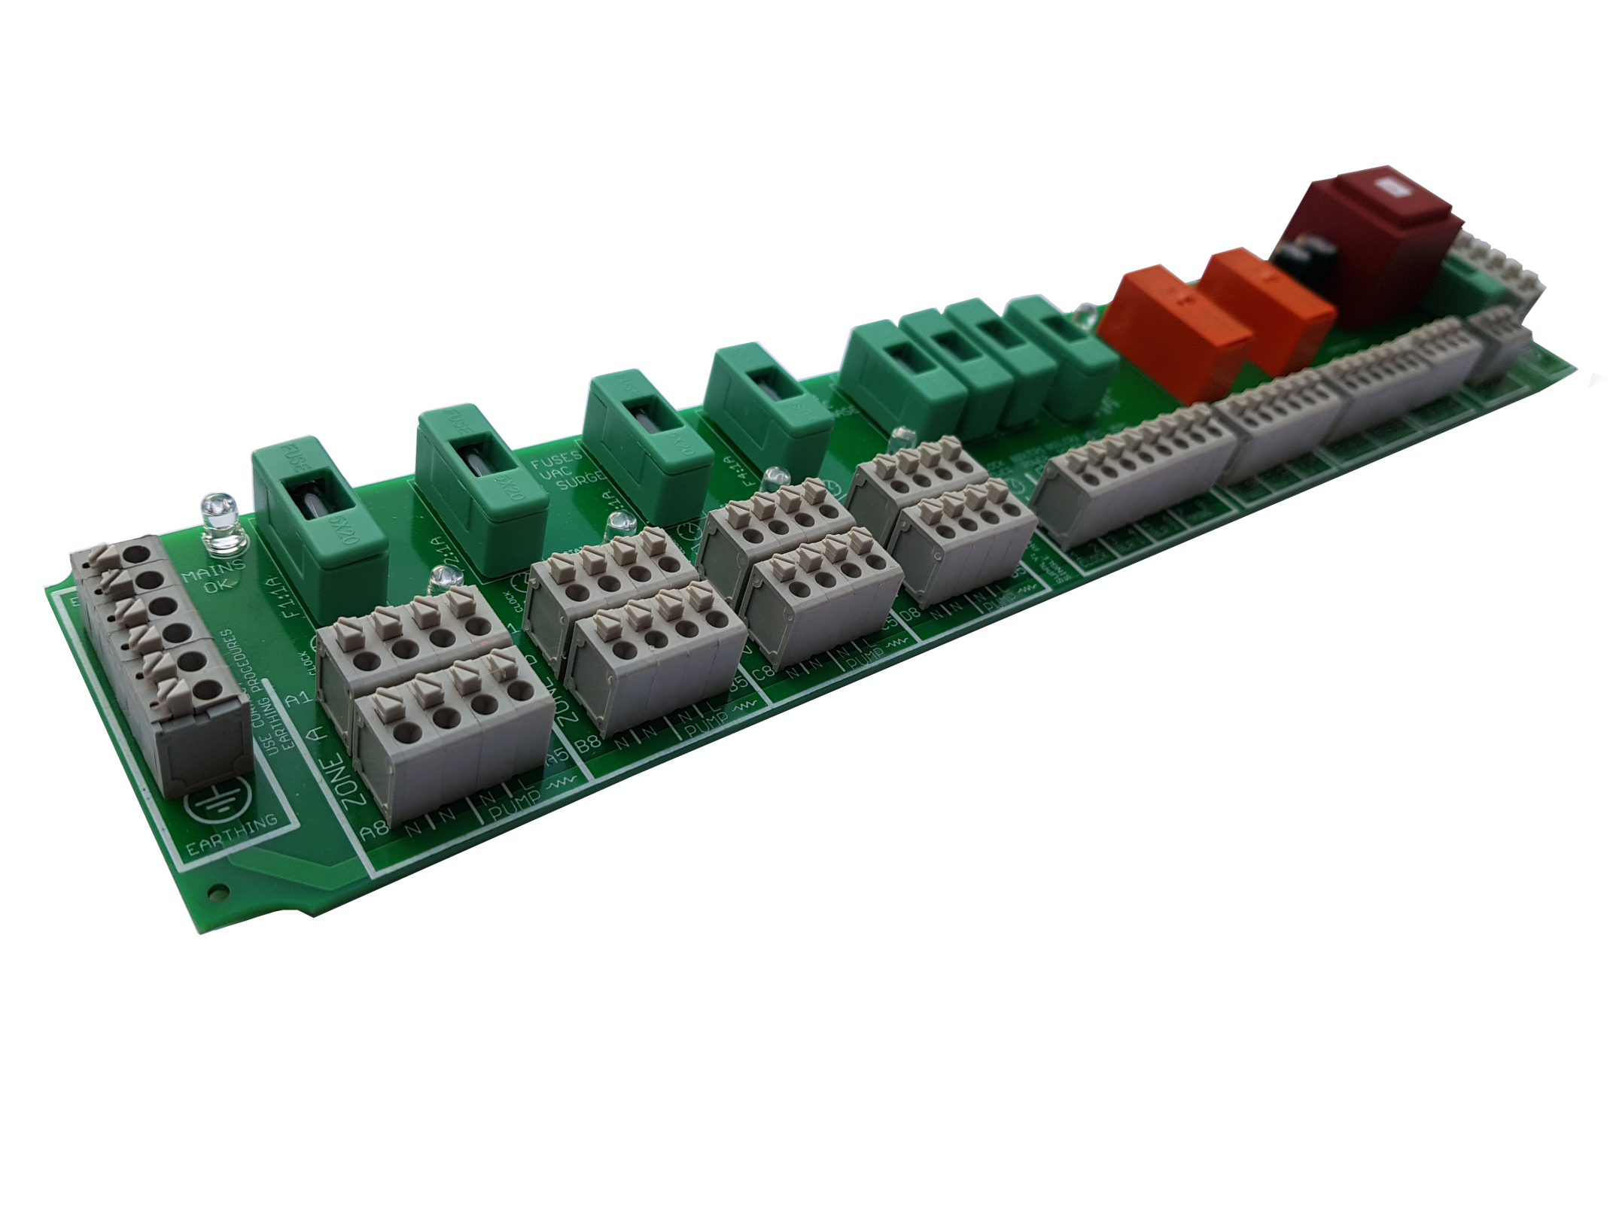
Introduction & Understanding Wiring Effective Efficient Central Heating Systems
The NRG Awareness Method

Slide 2
ELIMINATE THE HASSEL IN WIRING GOOD HEATING SYSTEMS
This webinar provides a technical understanding of wiring Heating Systems with the NRG Lex - System Controls Module
To help you understand the essential characteristics of good heating system control installation and practices.
Provide a better grasp of control wiring to improve customer comfort generation and proper DHW provision.
Show you how to wire simple, cost effective and reliable systems without sacrificing energy efficiency or comfort.
Maximise the potential for your clients heating system satisfaction with energy saving wiring techniques and equipment

Slide 3
6.3 A Fused Power Supply - 230 V ~, 50 Hz / 60Hz, Single Phase
2 Fused (3 A) Boiler Power Supplies
4 Fused (1 A) Zones with Connections for Time and Temperature Controls
Fused (3 A) Auxiliary Provision -
LED Indication for Zone, Boiler Calls and Auxiliary Operation
Optional Frost Input to Boiler Call
Easy ‘Push-Open’ Connections for 0.5 to 1.5 mm2 Cable
4 Isolated Inputs with additional output connections & 2 Isolated Relay Outputs (C,NO,NC)
2 Optional Voltage-free or Switch-live Boiler Firing Control Circuits
Provides power and safety control for solid fuel interlinked systems.

Slide 5
Zone
Controls
Power
Supply
Boiler
Control

Slide 6
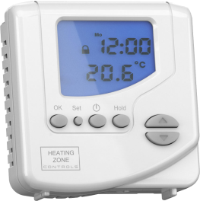
Zone Controls
Power Supply
Boiler Control
Power
LED
Blr
LED
R1
1A
1A
1A
1A
3A
3A
3A
5A
1
2
3
4
L
N
L
N
L
N
L
N
FROST
C
NO
C
NO
5
6
7
8
Clock
Power
Boiler
One
Boiler
Two
Mains
Power Supply
Time & Temperature
Control Example
Zone
LED
A2
A1
A5
A6
A7
A8
A4
A3
Zone A
Zone
LED
B2
B1
B5
B6
B7
B8
B4
B3
Zone B
Zone Connections
Zone
LED
C2
C1
C5
C6
C7
C8
C4
C3
Zone C
Zone
LED
D2
D1
D5
D6
D7
D8
D4
D3
Zone D
Zone Stat Output
Devices
Zone Stat Input - Call Input
Zone Neutral Connections
Fused : Permanent Live to all Zone Controls
Live From Zone Time Controls

Slide 7
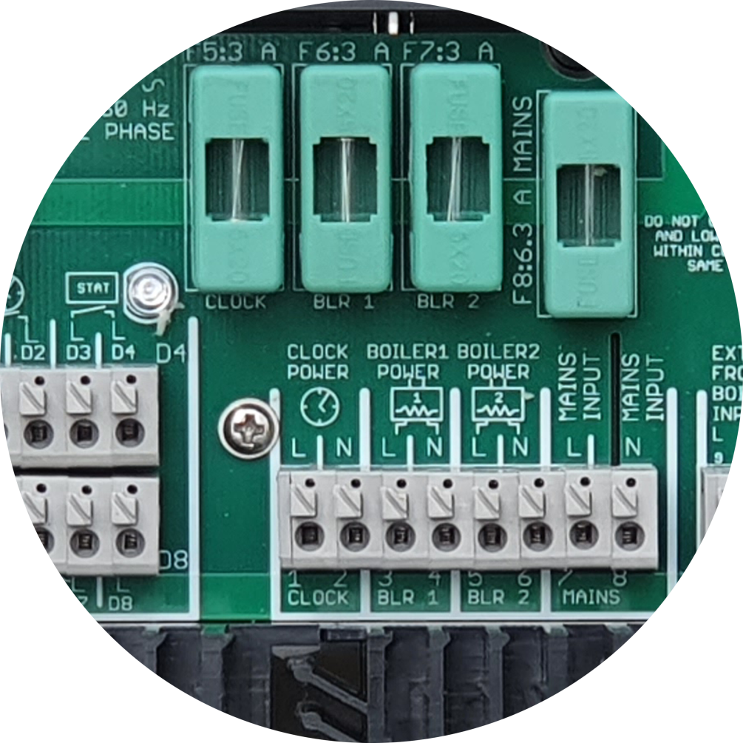
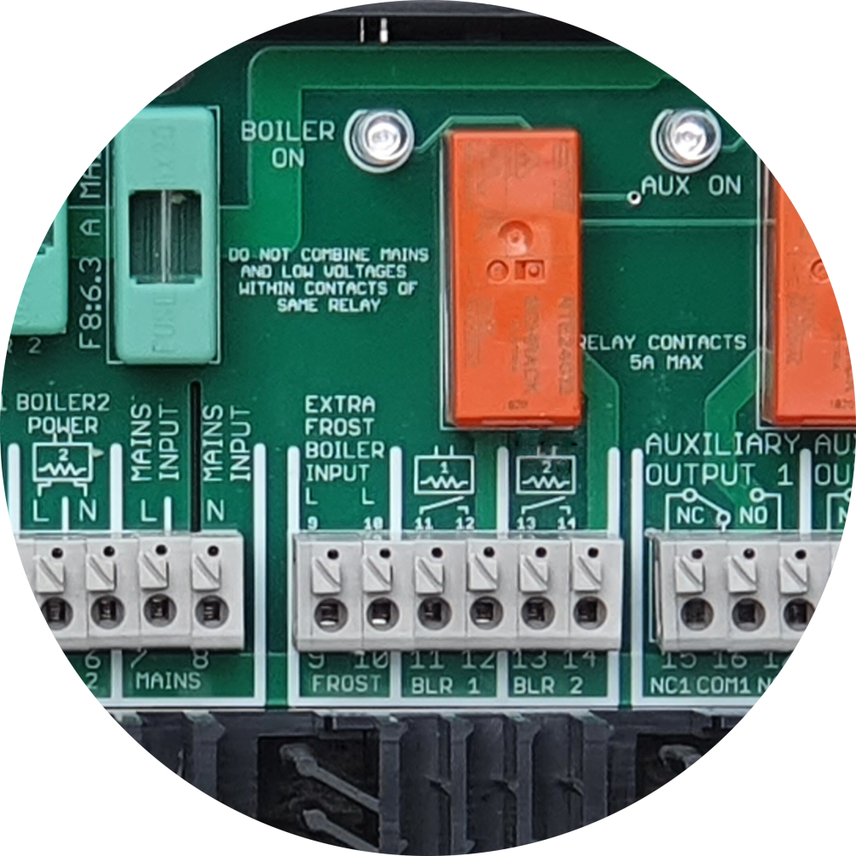
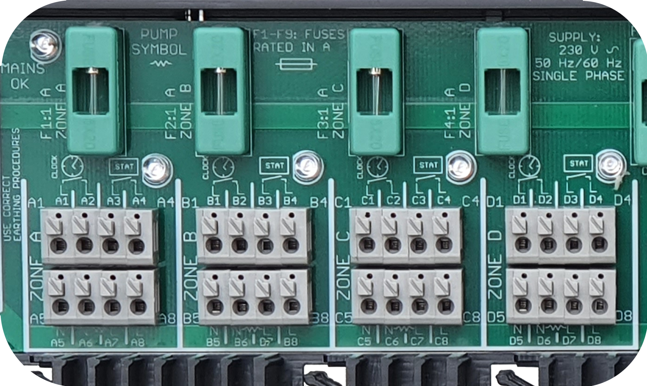
Auxiliary Relay &
Auxiliary Power Supply
BOILER SWITCHING WIRING CONNECTIONS
ZONE WIRING CONNECTIONS
POWER SUPPLIES

Slide 8
AUXILIARY RELAY WIRING CONNECTIONS
To Zone
Control
N
Auxiliary
LED
L
R1
5A
3A
Time & Temperature
Control Example
L
L
L
L
L
N
{ }
NC
C
NO
NO
C
NC
L
L
L
L
N
N
L1
L2
L3
L4
7
8
15
16
17
18
19
20
21
22
23
24
25
26
27
28
29
30
Mains
Power Supply
Auxiliary
Relay
Contacts
Isolated
Auxiliary
Relay Inputs
Auxiliary
Power Supply

Slide 9
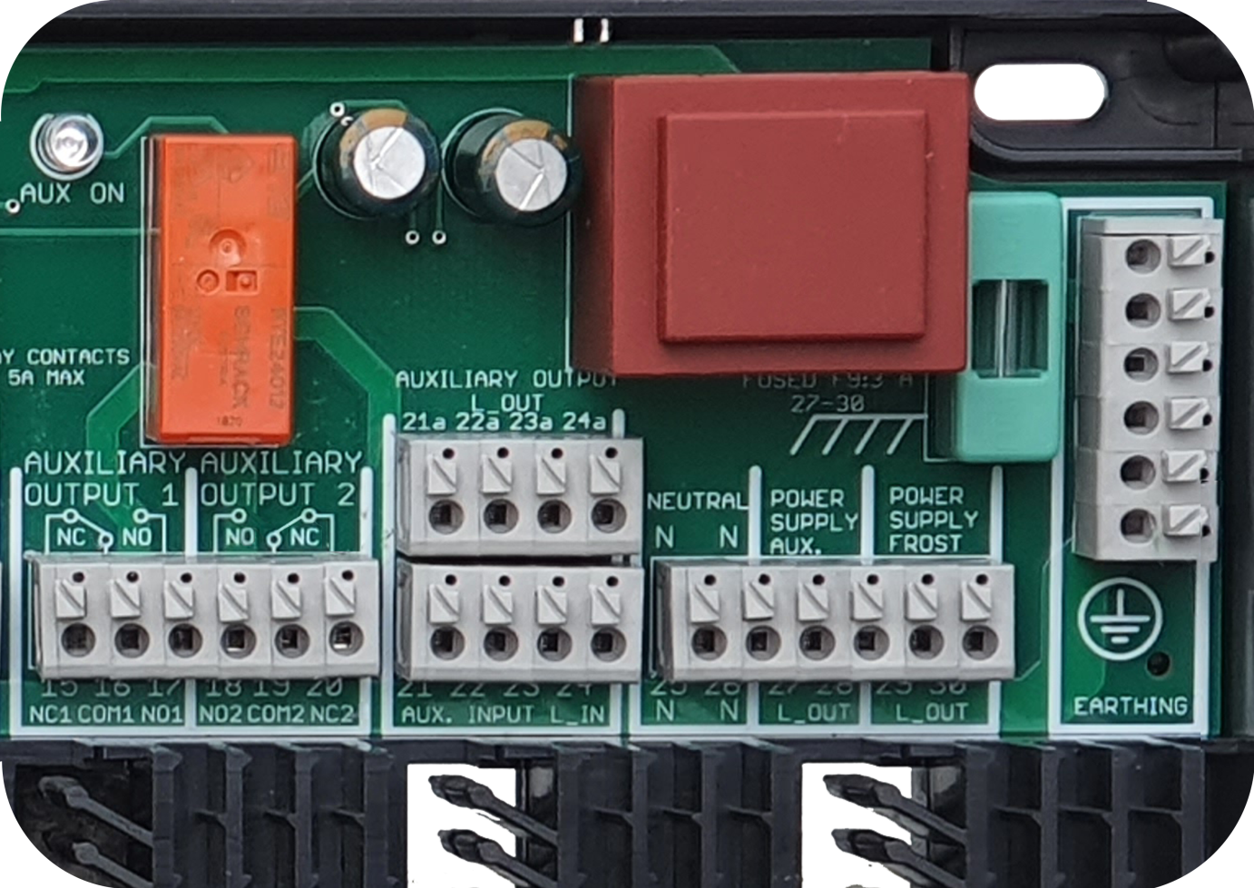
AUXILIARY RELAY WIRING CONNECTIONS

Slide 10
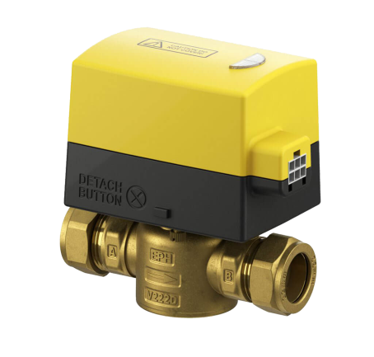
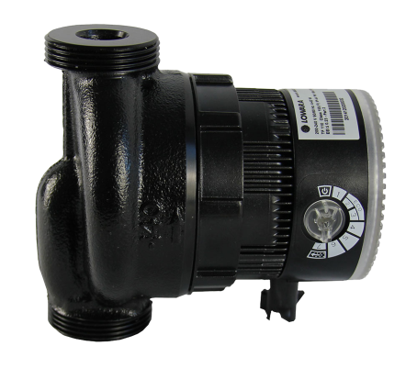
PUMP OR VALVE WIRING CONNECTIONS
PUMP WIRING
MOTORISED VALVE WIRING
BROWN
Live
Auxiliary
Power Supply
1
2
3
4
1
2
3
4
N
N
L1
L2
L3
L4
5
6
7
8
5
6
7
8
25
26
27
28
29
30
BLUE
Neutral
LIVE
BLUE
Neutral
ORANGE
Switch Live
GREY
Live
EARTH
EARTH

Slide 11
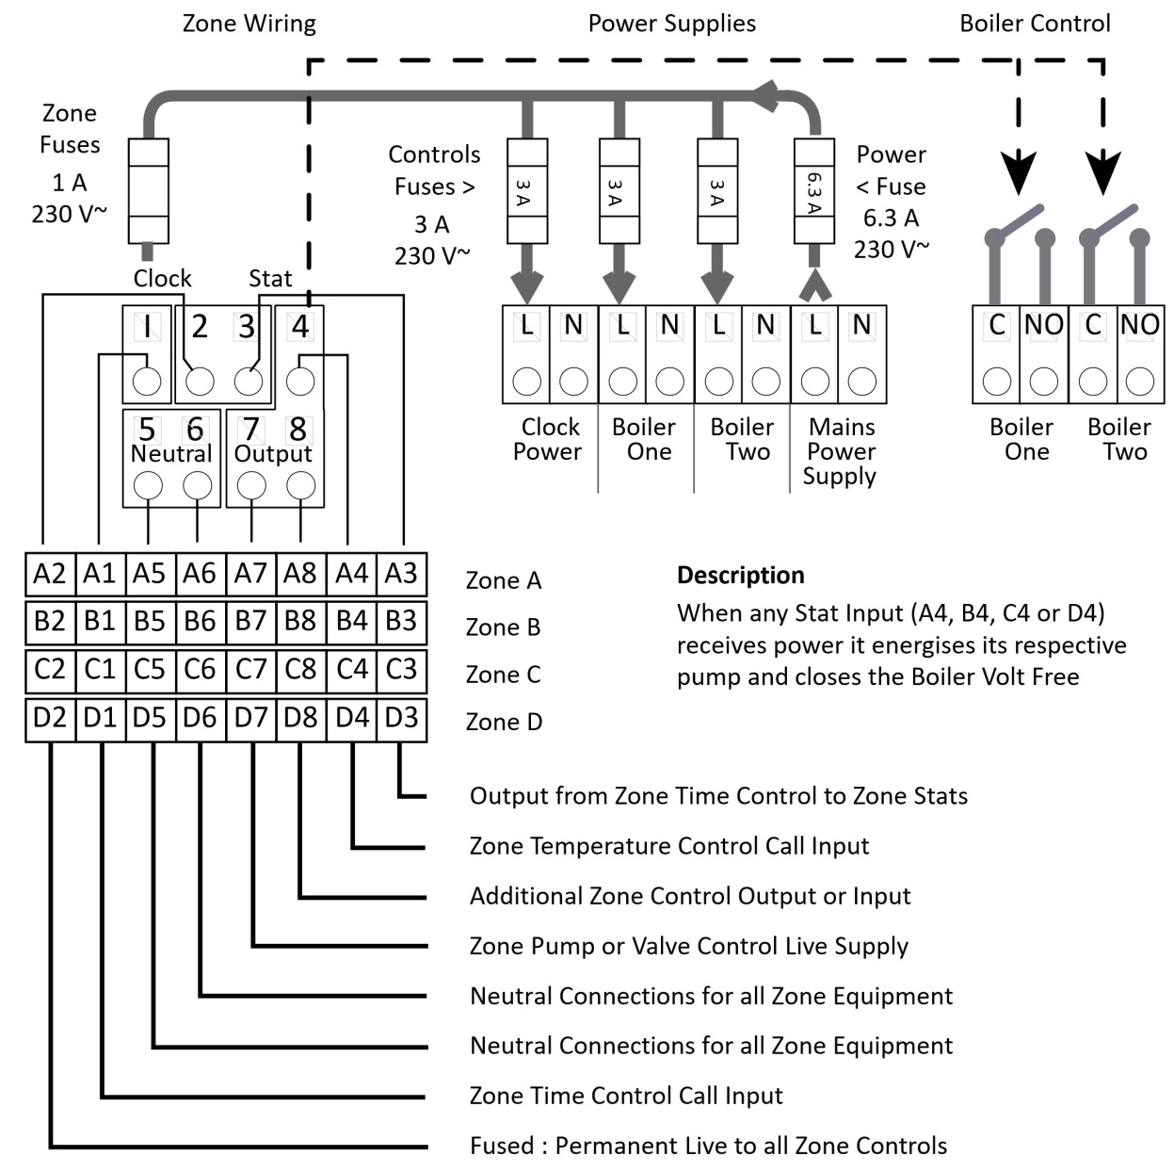
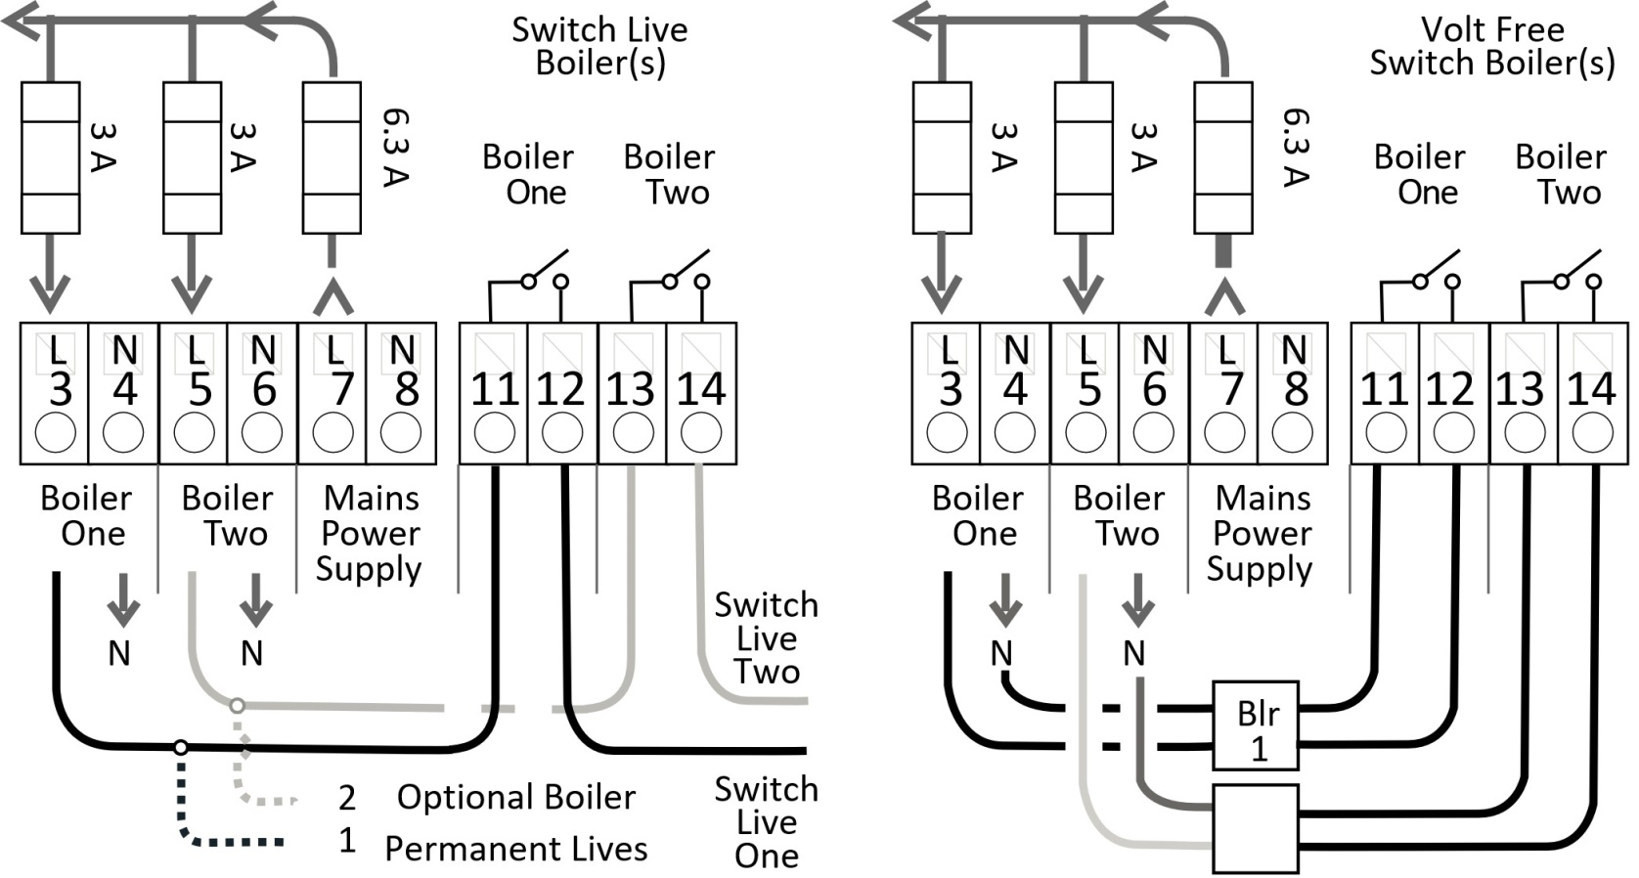
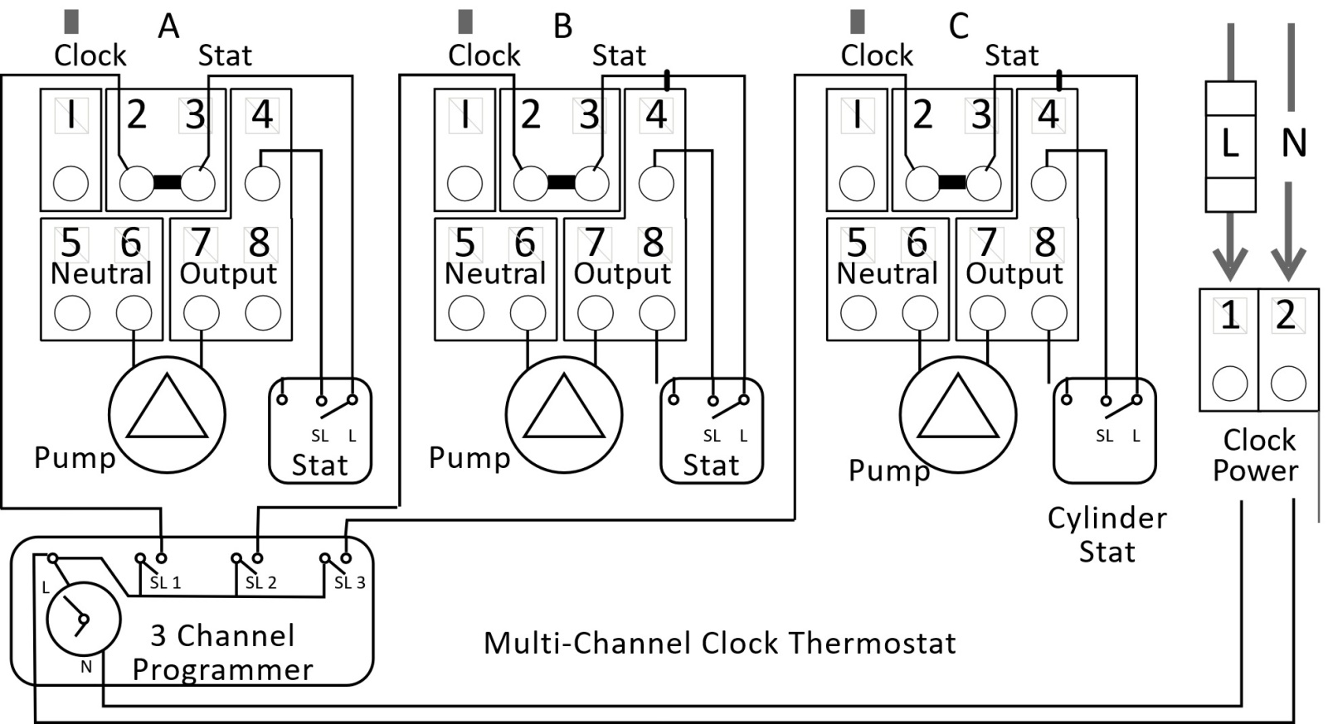
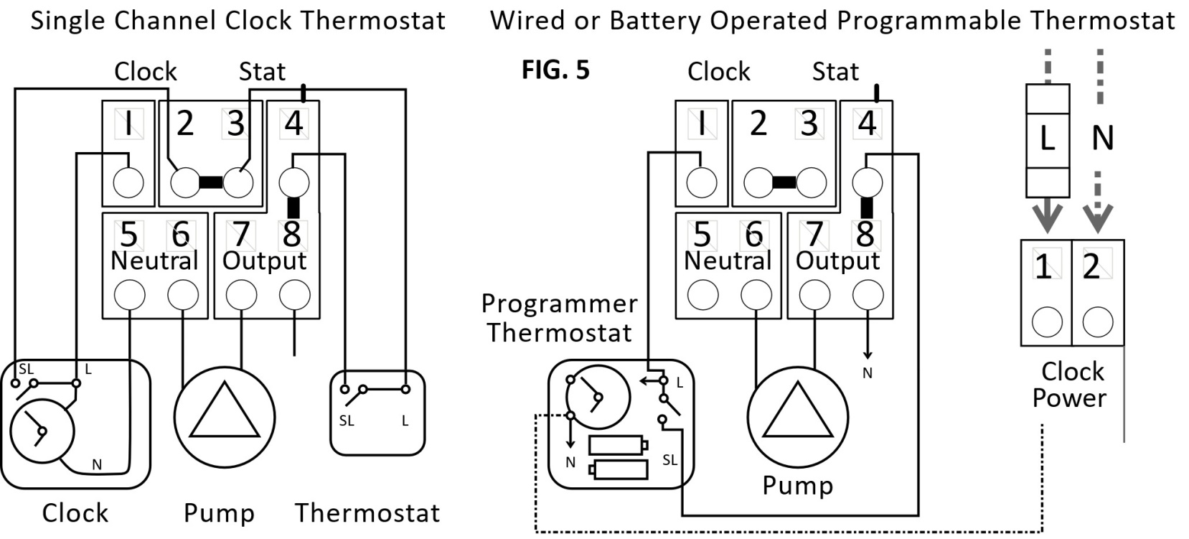
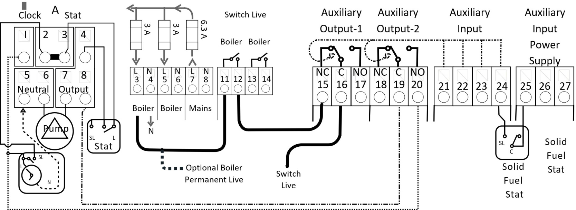
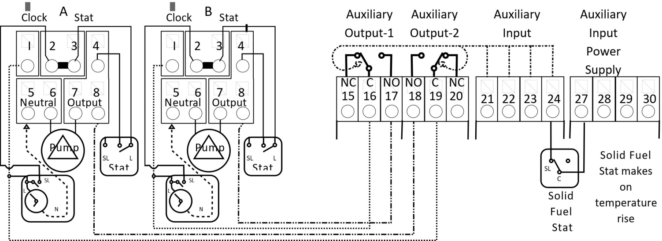

Slide 12
Diagrams

Slide 13
Thank You
for Your Time
System Diagrams

Slide 14
SYSTEM WIRING DIAGRAMS
1 Pellet Boiler - Electric Boiler - 2 Central Heating Zones - 1 DHW Zone
2 Oil Boiler - Solid Fuel Stove - 2 Central Heating Zones - 1 DHW Zone
3 Oil Boiler - 4 Central Heating Zones
4 Oil Boiler - Solid Fuel Stove - 2 Central Heating Zones - 1 DHW Zone - Motorised Valves
5 Oil Boiler - Solid Fuel Stove - 1 Underfloor Heating Zone - 1 Radiator Zone - 1 DHW Zone
6 Oil Boiler - Solid Fuel Stove - 1 Central Heating Zone - 1 DHW Zone
7 Oil Boiler - 2 Solid Fuel Stoves - 1 Central Heating Zone - 1 DHW Zone
8 Gas Boiler - 1 Underfloor Heating Zone - 2 Radiator Zones
9 NRG Link - Heat Pump - Solid Fuel Stove - 3 Central Heating Zones - 1 DHW Zone
10 Heat Pump - 1 Underfloor Heating - 1 Radiator Zone - 1 DHW Zone
11 Gas Boiler With Voltage Free Switching - 2 Central Heating Zones - 1 DHW Zone
12 Gas Boiler With Switch Live Switching - 2 Central Heating Zones - 1 DHW Zone
13 Buffer Tank - 3 Underfloor Heating Zones - 1 DHW Zone
14 NRG Lex Interconnection - Gas Boiler- 7 Central Heating Zones - 1 DHW Zone

Slide 15
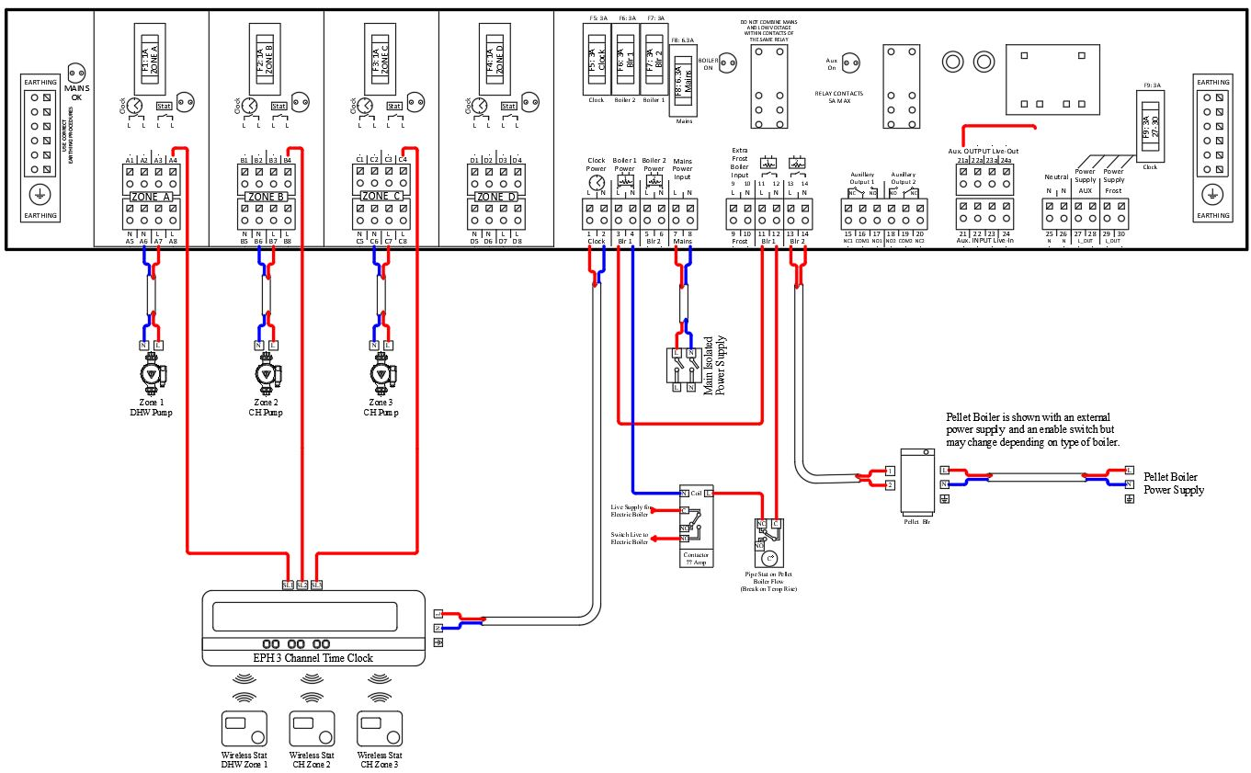
Diagram Ref 1

Slide 16
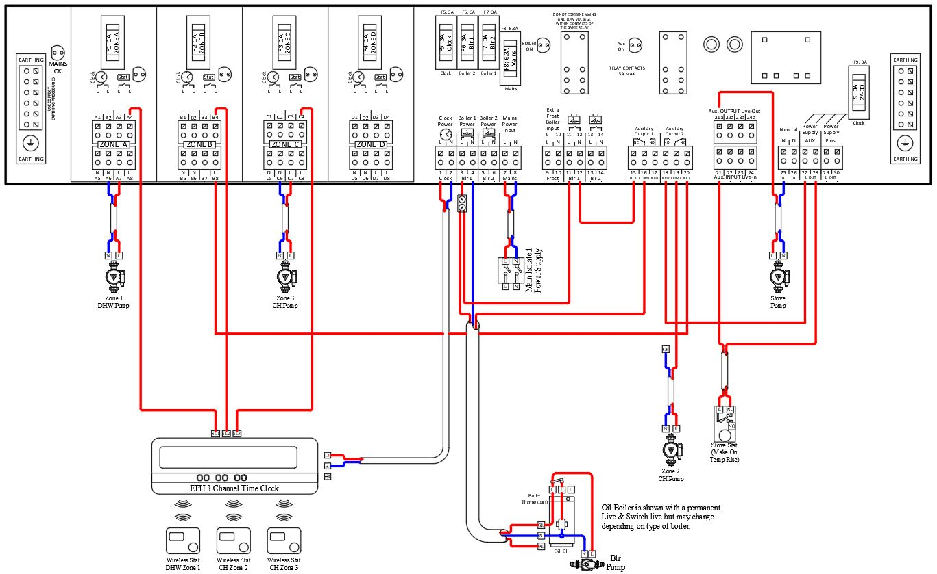
Diagram Ref 2

Slide 17
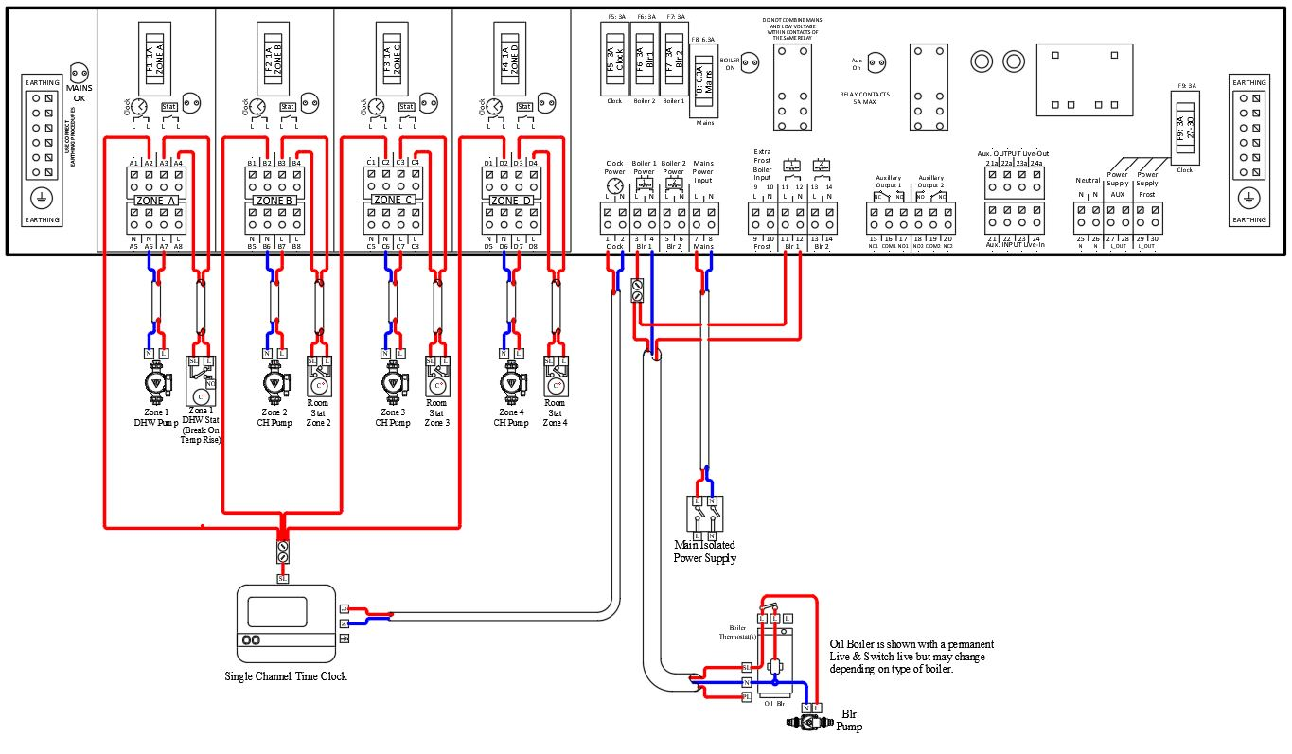
Diagram Ref 3

Slide 18
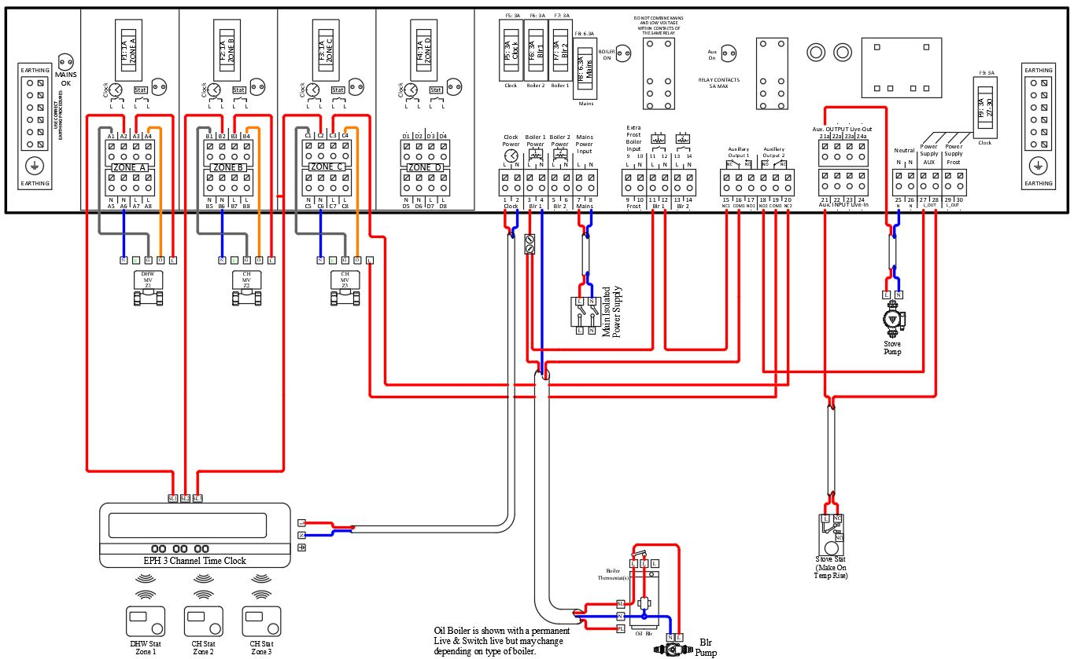
Diagram Ref 4

Slide 19
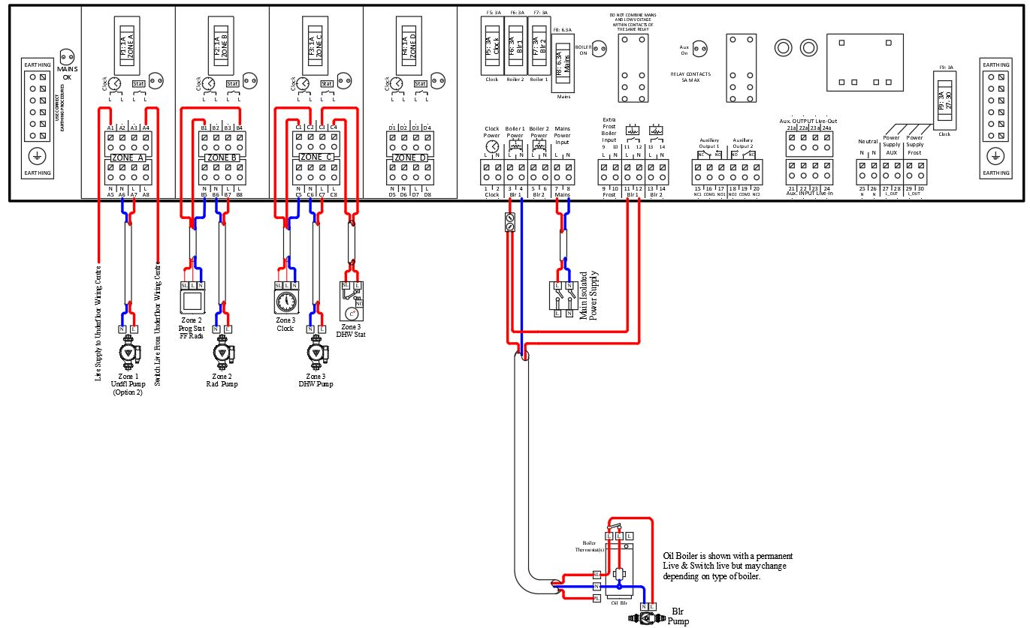
Diagram Ref 5

Slide 20
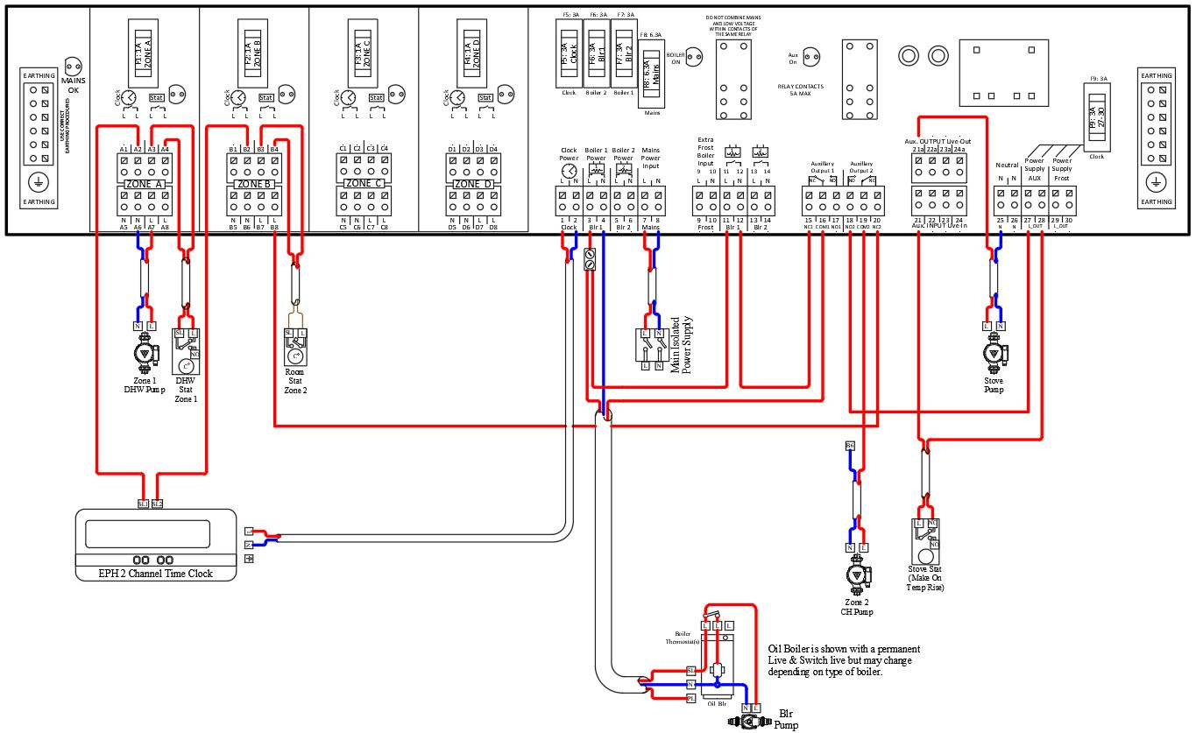
Diagram Ref 6

Slide 21
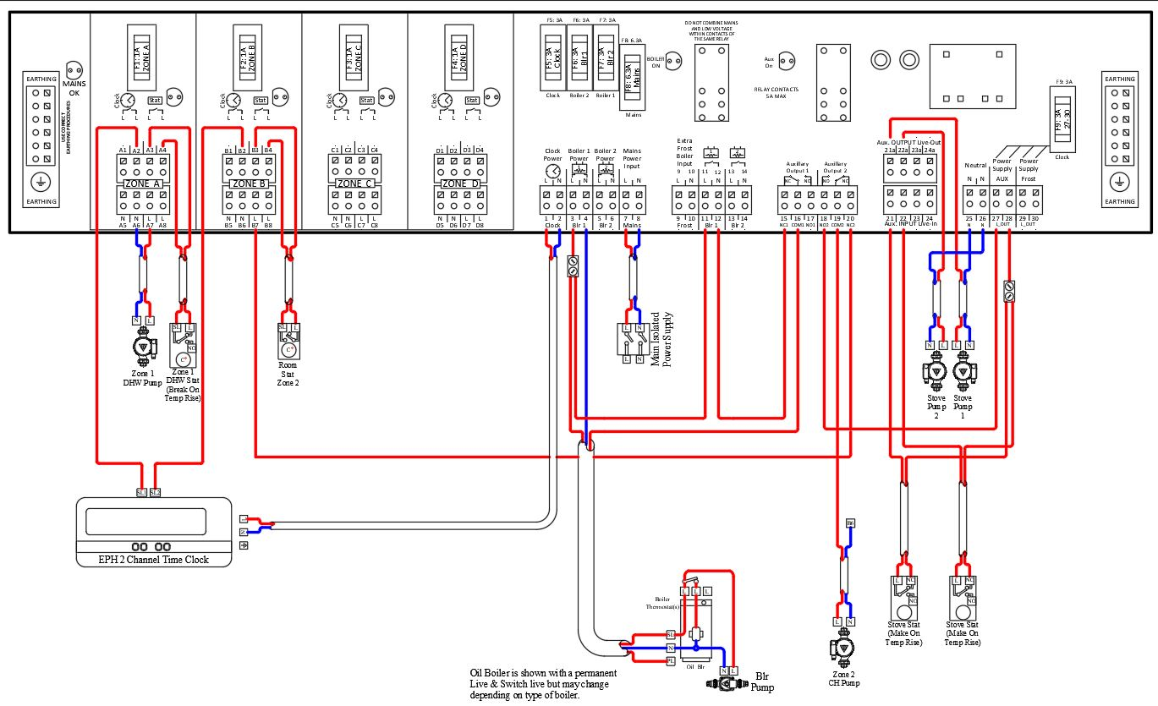
Diagram Ref 7

Slide 22
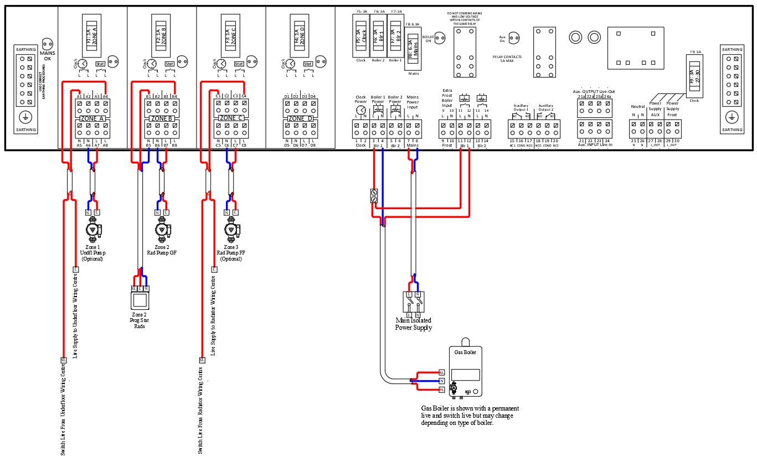
Diagram Ref 8

Slide 23
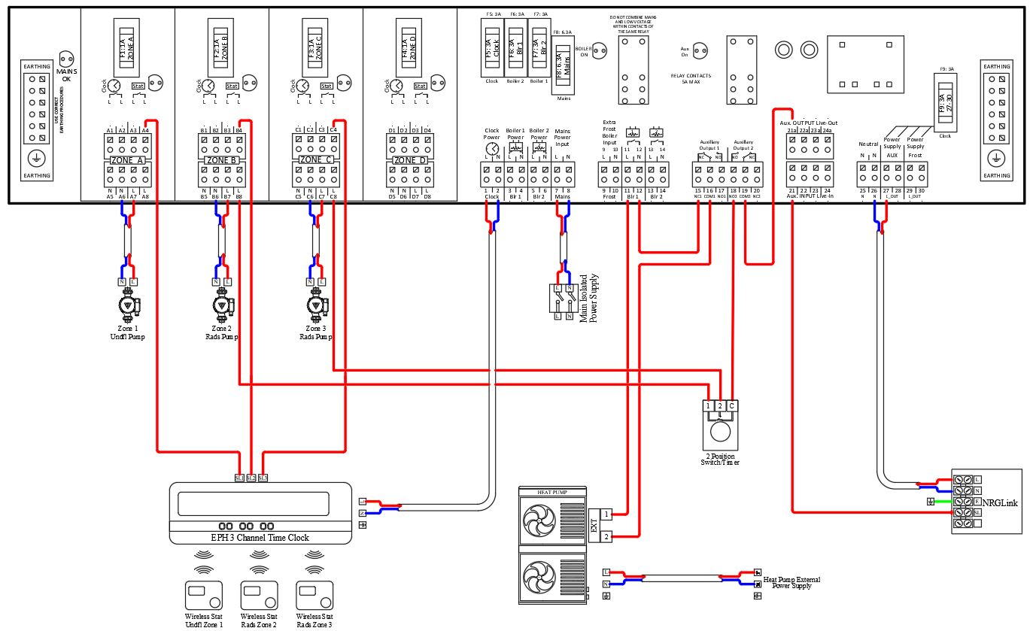
Diagram Ref 9

Slide 24
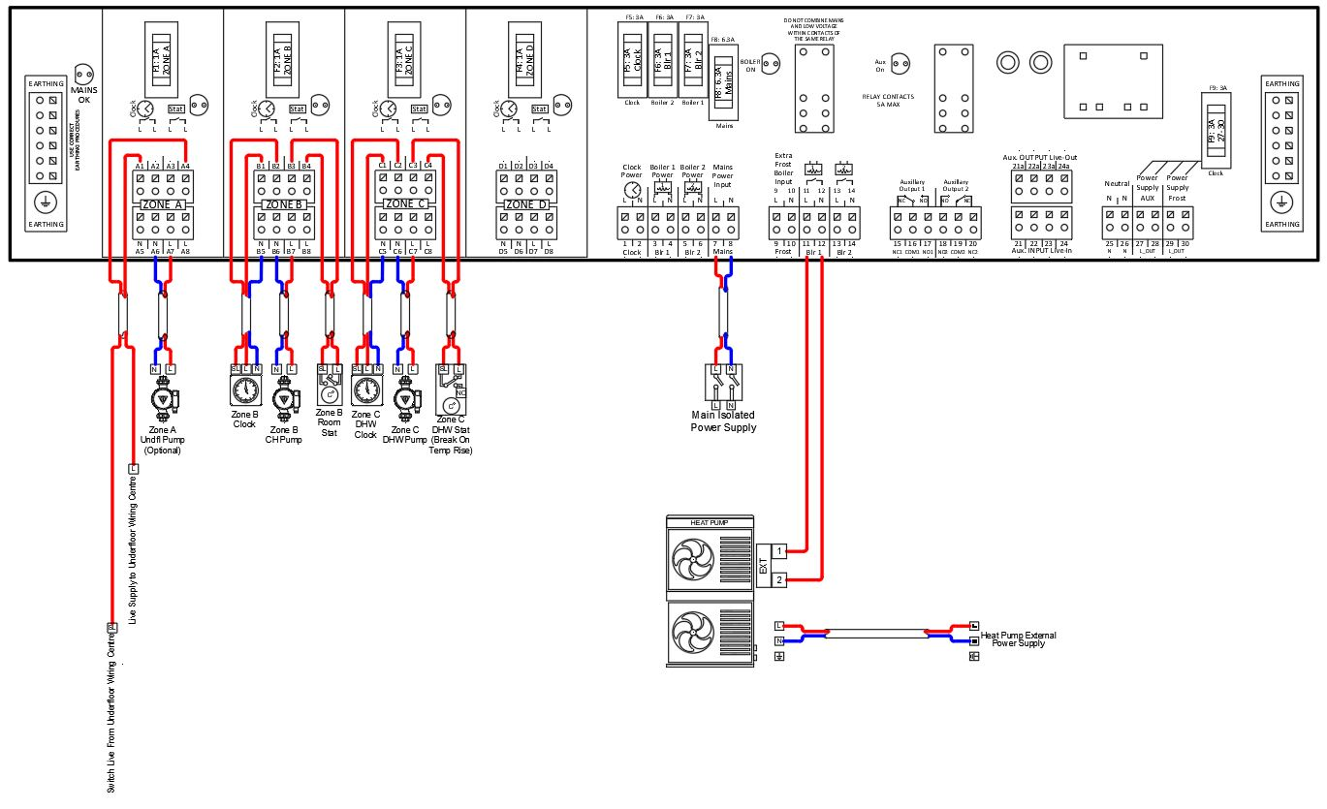
Diagram Ref 10

Slide 25
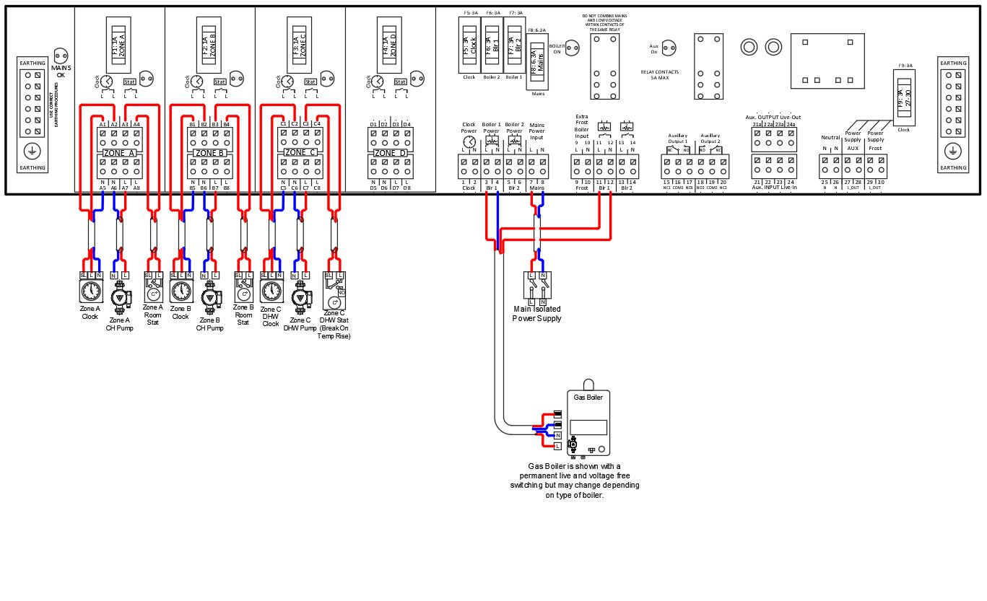
Diagram Ref 11

Slide 26
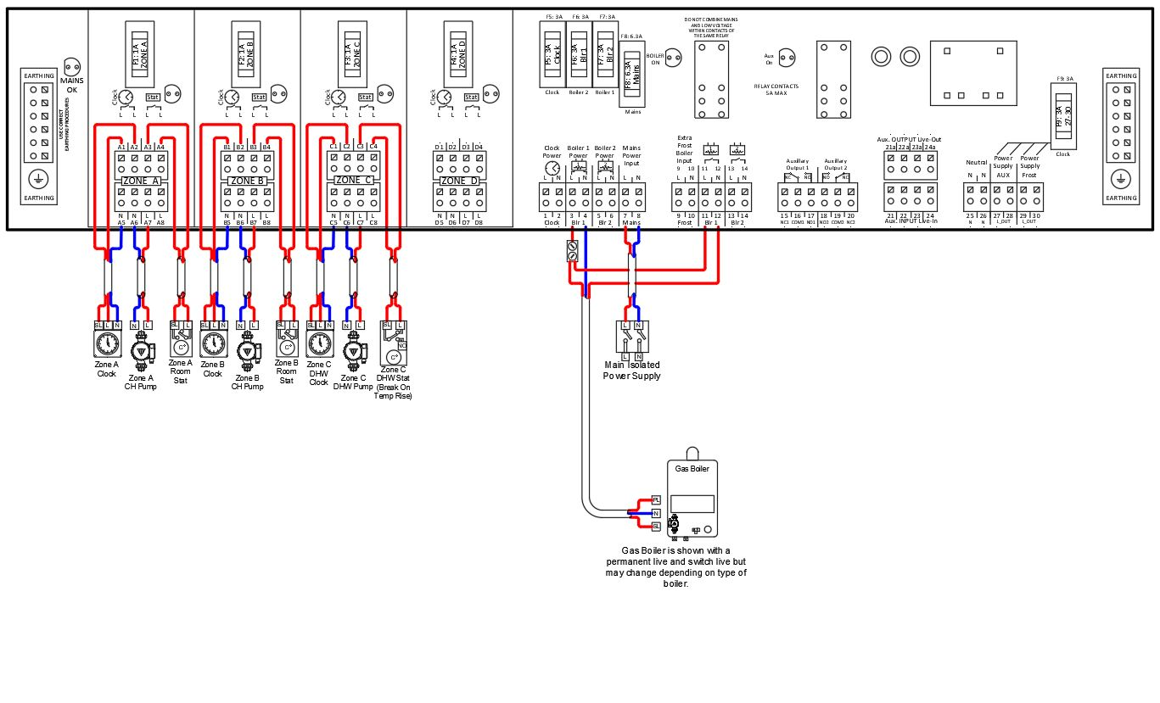
Diagram Ref 12

Slide 27
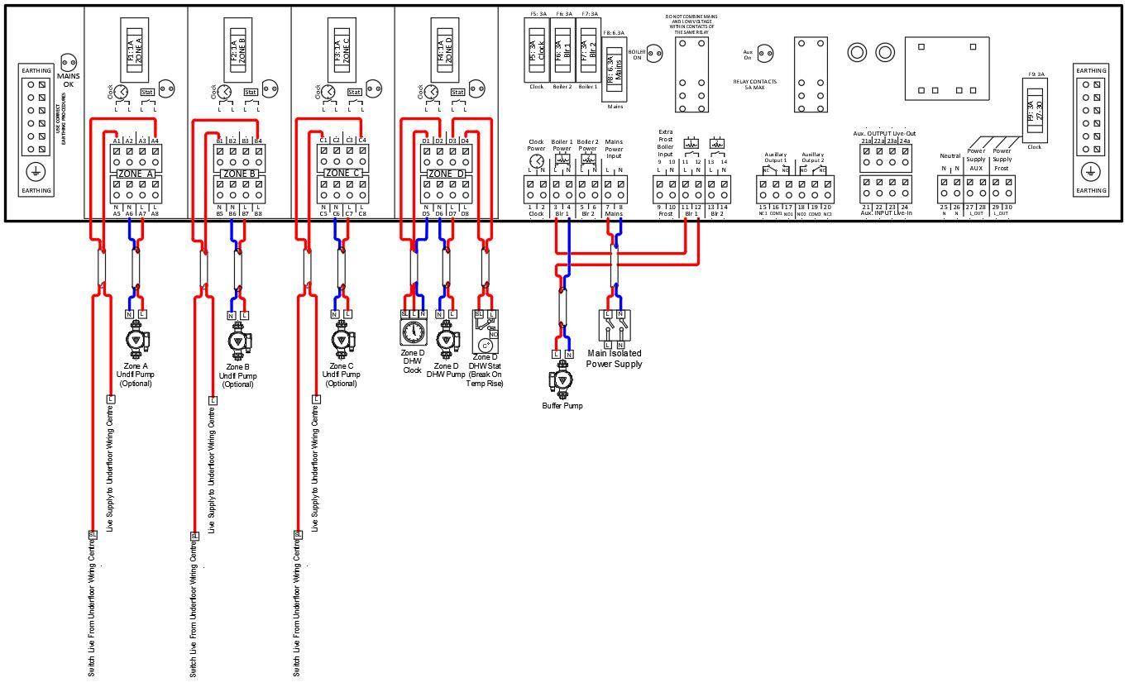
Diagram Ref 13

Slide 28
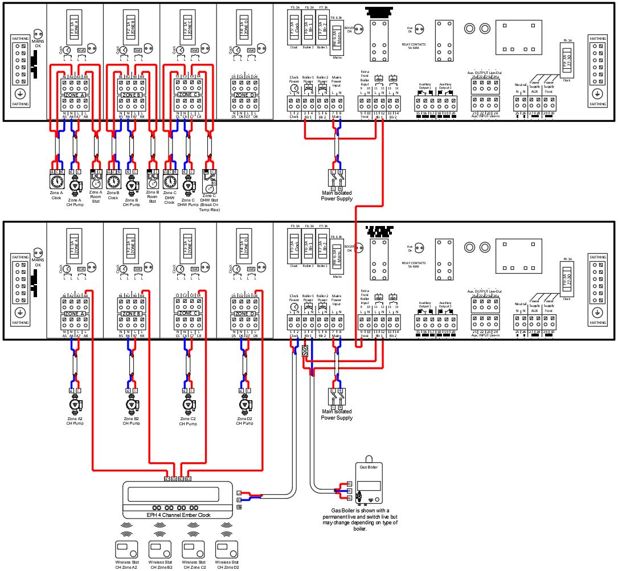
Diagram Ref 14

Slide 29
Thank You
for Your Time

